Slide 1
The Theory of NP-Completeness

Slide 2
Nondeterministic algorithms
A nondeterminstic algorithm consists of
phase 1: guessing
phase 2: checking
If the checking stage of a nondeterministic algorithm is of polynomial time-complexity, then this algorithm is called an NP (nondeterministic polynomial) algorithm.
NP problems : (must be decision problems)
  e.g. searching, MST
    sorting
    satisfiability problem (SAT)
    traveling salesperson problem (TSP)
3- <number>

Slide 3
Nondeterministic operations and functions
Choice(S) : arbitrarily chooses one of the elements in set S
Failure : an unsuccessful completion
Success : a successful completion
Nonderministic searching algorithm:
j ← choice(1 : n) /* guessing */
if A(j) = x then success /* checking */
else failure
3- <number>
3- <number>

Slide 4
A nondeterministic algorithm terminates unsuccessfully iff there exist no a set of choices leading to a success signal.
The time required for choice(1 : n) is O(1).
A deterministic interpretation of a non-deterministic algorithm can be made by allowing unbounded parallelism in computation.
3- <number>
3- <number>

Slide 5
Nondeterministic sorting
B ← 0
/* guessing */
for i = 1 to n do
j ← choice(1 : n)
if B[j] ≠ 0 then failure
B[j] = A[i]
/* checking */
for i = 1 to n-1 do
if B[i] > B[i+1] then failure
success
3- <number>
3- <number>

Slide 6
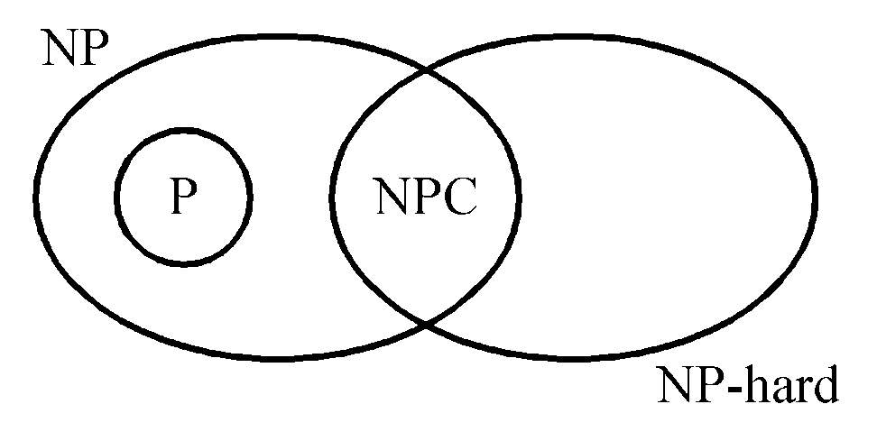
NP : the class of decision problem which can be solved by a non-deterministic polynomial algorithm.
P: the class of problems which can be solved by a deterministic polynomial algorithm.
NP-hard: the class of problems to which every NP problem reduces.
NP-complete (NPC): the class of problems which are NP-hard and belong to NP.
3- <number>

Slide 7
Some concepts of NPC
Definition of reduction: Problem A reduces to problem B (A ∝ B) iff A can be solved by a deterministic polynomial time algorithm using a deterministic algorithm that solves B in polynomial time. B is harder.
Up to now, none of the NPC problems can be solved by a deterministic polynomial time algorithm in the worst case.
It does not seem to have any polynomial time algorithm to solve the NPC problems.
3- <number>

Slide 8
The theory of NP-completeness always considers the worst case.
The lower bound of any NPC problem seems to be in the order of an exponential function.
Not all NP problems are difficult. (e.g. the MST problem is an NP problem.)
If A, B ∈ NPC, then A ∝ B and B ∝ A.
Theory of NP-completeness
If any NPC problem can be solved in polynomial time, then all NP problems can be solved in polynomial time. (NP = P)
3- <number>

Slide 9
Decision problems
The solution is simply “Yes” or “No”.
Optimization problems are more difficult.
e.g. the traveling salesperson problem
  Optimization version:
  Find the shortest tour
  Decision version:
  Is there a tour whose total length is less than or equal to a constant c ?
3- <number>

Slide 10
Solving an optimization problem by a decision algorithm :
Solving TSP optimization problem by decision algorithm :
  Give c₁ and test (decision algorithm)
Give c₂ and test (decision algorithm)

Give c_{n} and test (decision algorithm)
  We can easily find the smallest c_{i}
3- <number>

Slide 11
The satisfiability problem
The satisfiability problem
  The logical formula :
x₁ v x₂ v x₃
& - x₁
& - x₂
  the assignment :
x₁ ← F , x₂ ← F , x₃ ← T
  will make the above formula true .
(-x₁, -x₂ , x₃) represents x₁ ← F , x₂ ← F , x₃ ← T
3- <number>

Slide 12
If there is at least one assignment which satisfies a formula, then we say that this formula is satisfiable; otherwise, it is unsatisfiable.
An unsatisfiable formula :
  x₁ v x₂
  & x₁ v -x₂
  & -x₁ v x₂
  & -x₁ v -x₂
3- <number>

Slide 13
Definition of the satisfiability problem: Given a Boolean formula, determine whether this formula is satisfiable or not.
A literal : x_{i} or -x_{i}
A clause : x₁ v x₂ v -x₃ ≡ C_{i}
A formula : conjunctive normal form
C₁& C₂ & … & C_{m}
3- <number>

Slide 14
Cook’s theorem
NP = P iff the satisfiability problem is a P problem.
SAT is NP-complete.
It is the first NP-complete problem.
Every NP problem reduces to SAT.
3- <number>

Slide 15
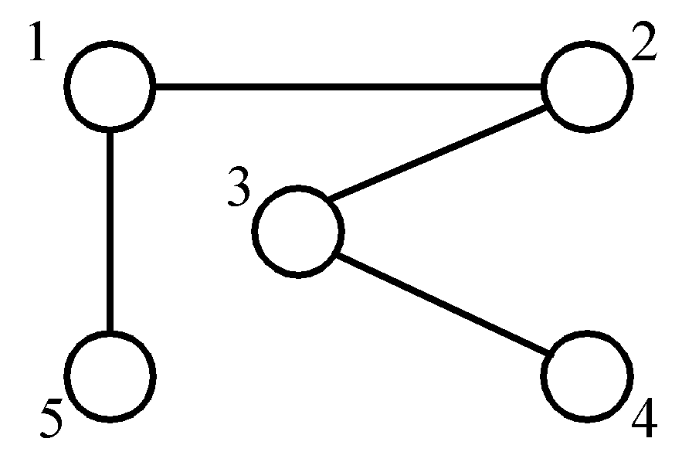
The vertex cover problem
Def: Given a graph G=(V, E), S is the node cover if S ⊆ V and for every edge (u, v) ∈ E, either u ∈ S or v ∈ S or both.
node cover :
{1, 3}
{5, 2, 4}
Decision problem : ∃ S ∋ | S | ≤ K ?
3- <number>

Slide 16
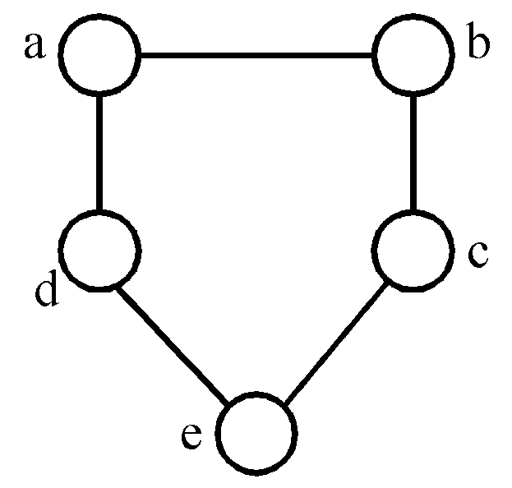
Chromatic number decision problem (CN)
Def: A coloring of a graph G=(V, E) is a function f : V → { 1, 2, 3,…, k } such that if (u, v) ∈ E, then f(u)≠f(v). The CN problem is to determine if G has a coloring for k.
E.g.
<Theorem> Satisfiability with at most 3 literals per clause (SATY) ∝ CN.
3-colorable
f(a)=1, f(b)=2, f(c)=1
f(d)=2, f(e)=3
3- <number>

Slide 17



Set cover decision problem
Def: F = {S_{i}} = { S₁, S₂, …, S_{k} }
S_{i} = { u₁, u₂, …, u_{n} }
T is a set cover of F if T ⊆ F and S_{i} = S_{i}
The set cover decision problem is to determine if F has a cover T containing no more than c sets.
example
F = {(a₁, a₃), (a₂, a₄), (a₂, a₃), (a₄), (a₁, a₃ , a₄)}
s₁ s₂ s₃ s₄ s₅
T = { s₁, s₃, s₄ } set cover
T = { s₁, s₂ } set cover, exact cover
3- <number>

Slide 18
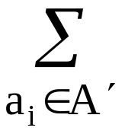
Sum of subsets problem
Def: A set of positive numbers A = { a₁, a₂, …, a_{n} }
  a constant C
  Determine if ∃ A′ ⊆ A ∋ a_{i} = C
e.g. A = { 7, 5, 19, 1, 12, 8, 14 }
  C = 21, A′ = { 7, 14 }
  C = 11, no solution
<Theorem> Exact cover ∝ sum of subsets.
3- <number>

Slide 19
Partition problem
Def: Given a set of positive numbers A = { a₁,a₂,…,a_{n} },
determine if ∃ a partition P, ∋ ∑a_{i} = ∑a_{i}
i∈p i∉p
e. g. A = {3, 6, 1, 9, 4, 11}
partition : {3, 1, 9, 4} and {6, 11}
<Theorem> sum of subsets ∝ partition
3- <number>

Slide 20
Bin packing problem
Def: n items, each of size c_{i} , c_{i} > 0
bin capacity : C
Determine if we can assign the items into
k bins, ∋ ∑c_{i} ≤ C , 1≤j≤k.
i∈bin_{j}
<Theorem> partition ∝ bin packing.
3- <number>

Slide 21
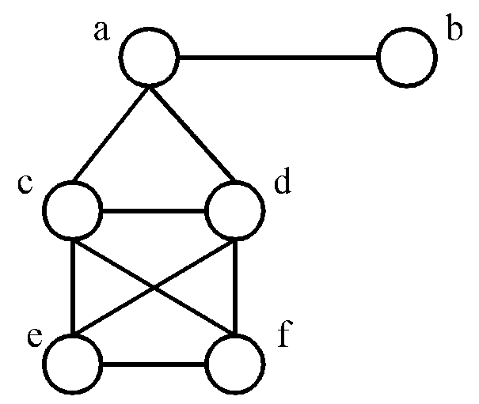
Max clique problem
Def: A maximal complete subgraph of a graph G=(V,E) is a clique. The max (maximum) clique problem is to determine the size of a largest clique in G.
e. g.
<Theorem> SAT ∝ clique decision problem.
maximal cliques :
{a, b}, {a, c, d}
{c, d, e, f}
maximum clique :
(largest)
{c, d, e, f}
3- <number>

Slide 22
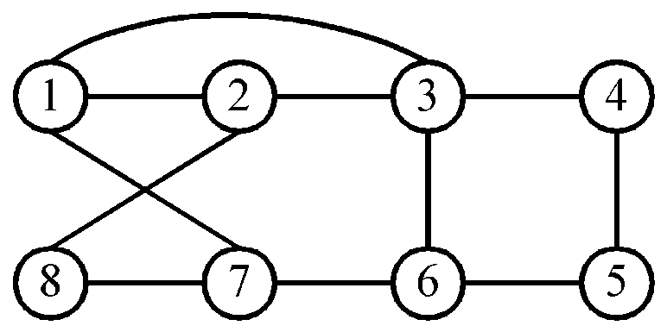
Hamiltonian cycle problem
Def: A Hamiltonian cycle is a round trip path along n edges of G which visits every vertex once and returns to its starting vertex.
e.g.
Hamiltonian cycle : 1, 2, 8, 7, 6, 5, 4, 3, 1.
<Theorem> SAT ∝ directed Hamiltonian cycle ( in a directed graph )
3- <number>

Slide 23
Traveling salesperson problem
Def: A tour of a directed graph G=(V, E) is a directed cycle that includes every vertex in V. The problem is to find a tour of minimum cost.
<Theorem> Directed Hamiltonian cycle ∝ traveling salesperson decision problem.
3- <number>

Slide 24
0/1 knapsack problem
Def: n objects, each with a weight w_{i} > 0
a profit p_{i} > 0
capacity of knapsack : M
Maximize ∑p_{i}x_{i}
1≤i≤n
Subject to ∑w_{i}x_{i} ≤ M
1≤i≤n
x_{i} = 0 or 1, 1≤ i ≤n
Decision version :
Given K, ∃ ∑p_{i}x_{i} ≥ K ?
1≤i≤n
Knapsack problem : 0 ≤ x_{i} ≤ 1, 1≤ i ≤n.
<Theorem> partition ∝ 0/1 knapsack decision problem.
3- <number>

Slide 25
Toward NP-Completeness:
Cook’s theorem:
The SAT problem is NP-complete.
Once we have found an NP-complete problem, proving that other problems are also NP-complete becomes easier.
Given a new problem Y, it is sufficient to prove that Cook’s problem, or any other NP-complete problems, is polynomially reducible to Y.
Known problem -> unknown problem
3- <number>

Slide 26
NP-Completeness Proof
The following problems are NP-complete: vertex cover(VC) and clique.
Definition:
A vertex cover of G=(V, E) is V’⊆V such that every edge in E is incident to some v∈V’.
Vertex Cover(VC): Given undirected G=(V, E) and integer k, does G have a vertex cover with ≤k vertices?
CLIQUE: Does G contain a clique of size ≥k?
3- <number>

Slide 27
NP-Completeness Proof: Vertex Cover(VC)
Problem: Given undirected G=(V, E) and integer k, does G have a vertex cover with ≤k vertices?
Theorem: the VC problem is NP-complete.
Proof: (Reduction from CLIQUE, i.e., given CLIQUE is NP-complete)
  VC is in NP. This is trivial since we can check it easily in polynomial time.
  Goal: Transform arbitrary CLIQUE instance into VC instance such that CLIQUE answer is “yes” iff VC answer is “yes”.
3- <number>

Slide 28

NP-Completeness Proof: Vertex Cover(VC)
  Claim: CLIQUE(G, k) has same answer as VC ( , n-k), where n = |V|.
  Observe: There is a clique of size k in G iff there is a VC of size n-k in .
3- <number>

Slide 29

NP-Completeness Proof: Vertex Cover(VC)
  Observe: If D is a VC in , then has no edge between vertices in V-D.
  So, we have k-clique in G n-k VC in
  Can transform in polynomial time.
3- <number>

Slide 30
NP-Completeness Proof: CLIQUE
Problem: Does G=(V,E) contain a clique of size k?
Theorem: Clique is NP-Complete. (reduction from SAT)
Idea: Make “column” for each of k clauses.
  No edge within a column.
  All other edges present except between x and x’
3- <number>

Slide 31
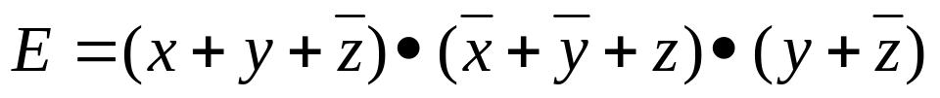






NP-Completeness Proof: CLIQUE
Example:
G =
G has m-clique (m is the number of clauses in E), iff E is satisfiable.
(Assign value 1 to all variables in clique)
3- <number>

